Slide 1
Gesture Recognisation to Use it as Virtual Mouse

Slide 2
Introduction
What is this project all about ?
When you move a particular object then it will detect its movement and use it for performing mouse related operations.
Languages and OS used
Language: Python
OS: Windows 10

Slide 3
System Architectuer Used
64 bit intel core i3 processor
4 GB RAM
1366x768 resolution screen
0.3 MP webcam
Python 2.7
OpenCV 2
NumPy
Pynput
WxPython

Slide 4
Project stages
Divided the project into two parts:
Part-I :
1. Planning
2. Development Environment Setup
3. Relevant study
4. Building object detection part
5. Deciding colour to be used and defining upper and lower bound
6. Masking of image frames
7. Morphological Operations
Part-II :
1. Deciding Mouse Operations
2. Fine Tuning of precision
3. Testing of Functionalities

Slide 5
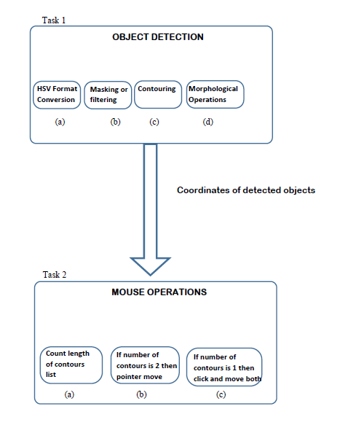
Modules Split-Up
Coordinates

Slide 6
Applications
Wireless mouse
Used as a basic gaming console
Writing on screen
Motion detection of a particular colour

Slide 7
Completed So far….
Divided the project into two parts:
Part-I :
1. Planning
2. Development Environment Setup
3. Relevant study
4. Building object detection part
5. Deciding colour to be used and defining upper and lower bound
6. Masking of image frames
7. Morphological Operations
Part-II :
1. Deciding Mouse Operations
2. Fine Tuning of precision
3. Testing of Functionalities

Slide 8
Implementation Part
Initialisation of Variables:
import cv2
import numpy as np
from pynput.mouse import Button, Controller
import wx
mouse=Controller()
app=wx.App(False)
(sx,sy)=wx.GetDisplaySize()
(camx,camy)=(320,240)
lowerBound=np.array([33,80,40])
upperBound=np.array([102,255,255])
cam= cv2.VideoCapture(0)
kernelOpen=np.ones((5,5))
kernelClose=np.ones((20,20))
pinchFlag=0
……to be Continued

Slide 9
Processing Image:
while True:
ret, img=cam.read()
img=cv2.resize(img,(340,220))
#convert BGR to HSV
imgHSV= cv2.cvtColor(img,cv2.COLOR_BGR2HSV)
# create the Mask
mask=cv2.inRange(imgHSV,lowerBound,upperBound)
#morphology
maskOpen=cv2.morphologyEx(mask,cv2.MORPH_OPEN,kernelOpen)
maskClose=cv2.morphologyEx(maskOpen,cv2.MORPH_CLOSE,kernelClose)
maskFinal=maskClose
conts,h=cv2.findContours(maskFinal.copy(),cv2.RETR_EXTERNAL,cv2.CHAIN_APPROX_NONE)
Mouse Pointer Move Operations:
if(len(conts)==2):
if(pinchFlag==1):
pinchFlag=0
mouse.release(Button.left)
x1,y1,w1,h1=cv2.boundingRect(conts[0])
x2,y2,w2,h2=cv2.boundingRect(conts[1])
cv2.rectangle(img,(x1,y1),(x1+w1,y1+h1),(255,0,0),2)
cv2.rectangle(img,(x2,y2),(x2+w2,y2+h2),(255,0,0),2)
cx1=x1+w1/2
cy1=y1+h1/2
cx2=x2+w2/2
cy2=y2+h2/2
cx=(cx1+cx2)/2
cy=(cy1+cy2)/2
cv2.line(img, (cx1,cy1),(cx2,cy2),(255,0,0),2)
cv2.circle(img, (cx,cy),2,(0,0,255),2)
mouseLoc=(sx-(cx*sx/camx), cy*sy/camy)
mouse.position=mouseLoc
while mouse.position!=mouseLoc:
pass

Slide 10
Mouse Pointer Click Operators:
if(len(conts)==1):
x,y,w,h=cv2.boundingRect(conts[0])
if(pinchFlag==0):
pinchFlag=1
mouse.press(Button.left)
cv2.rectangle(img,(x,y),(x+w,y+h),(255,0,0),2)
cx=x+w/2
cy=y+h/2
cv2.circle(img,(cx,cy),(w+h)/4,(0,0,255),2)
mouseLoc=(sx-(cx*sx/camx), cy*sy/camy)
mouse.position=mouseLoc
while mouse.position!=mouseLoc:
pass

Slide 11
Thank You !

